Slide 1
Mumbai Trans Harbor Link
Group Members:
Vivitsa Jain (190040132)
Bhanu Teja Kinjarapu (180040054)
Prerna Priya (190040077)
Rajesh Kumar (200040117)

Slide 2
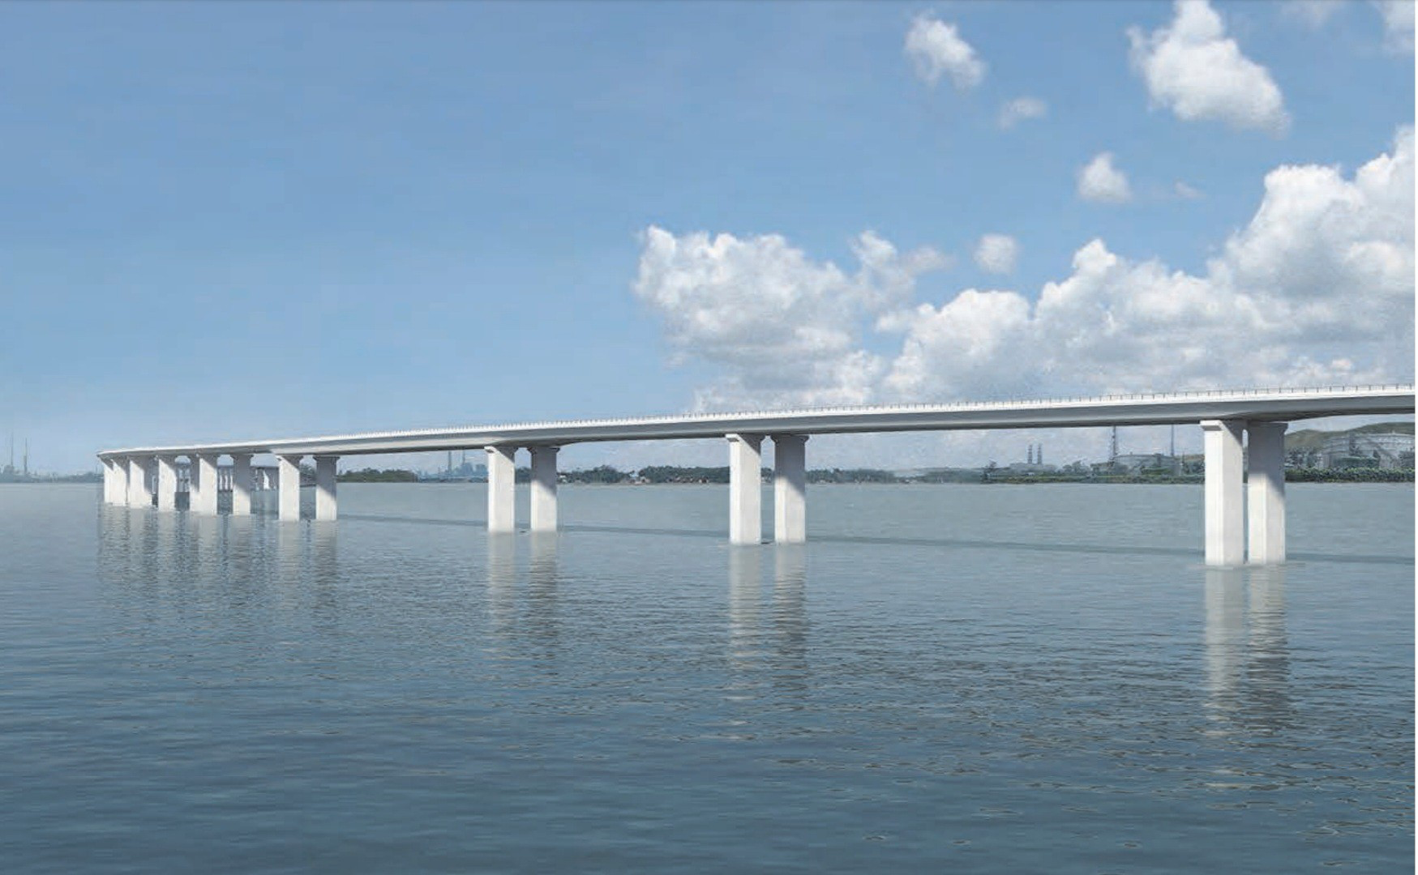
About The Project
To facilitate movement between Mumbai and Navi Mumbai
Route to the proposed Navi Mumbai Airport and for regional development
Proposed Specifics: - Length: 21.8 km - No. of lanes: 6 - Width: ~30 m
Financing by: Japan International Cooperation Agency (JICA)
Construction by: L&T
Reported Present Status: 83% completion
Source: MMRDA Website

Slide 3
Project Parameters
Project Period
Project Schedule
Inflation Rate
35 years
7 yrs of construction + 28 yrs of operation
Construction: 2015-2021 Operation: 2022-2049
Assumed at 5%
(based on IMF WEO, April 2015)
Source: JICAA Project Analysis Report

Slide 4
Financial Analysis

Slide 5
Costs
Financial Costs include Investments during the construction period and O&M during the operation period
Investment Costs
O&M Costs
Source: JICAA Project Analysis Report

Slide 6
Estimated Toll Rates (1/2) (Year 2022)
Vehicle Type | Case 1 (-50%) |  | Case 2 (Base Case on survey) |  | Case 3 (+50%)
 | Chirle IC - ShivajiNagar IC | ShivajiNagar IC - Sewri IC | Chirle IC - ShivajiNagar IC | ShivajiNagar IC - Sewri IC | Chirle IC - ShivajiNagar IC | ShivajiNagar IC - Sewri IC
 | 5km | 16.5km | 5km | 16.5km | 5km | 16.5km
Car | 30 | 90 | 55 | 180 | 80 | 270
Bus | 60 | 210 | 130 | 420 | 190 | 630
LCV | 40 | 120 | 70 | 240 | 110 | 360
HCV | 60 | 210 | 130 | 420 | 190 | 630
MAV | 90 | 300 | 180 | 600 | 270 | 900
Note: Click respective links to view excel
Source: JICAA Project Analysis Report

Slide 7
Estimated Toll Rates (2/2)
Annual Revisions in toll rates as per the National Highways Fee (Determination of rates and collection) rules, 2008.
Applicable fee = base fee + (base fee × (WPI_{A}-WPI_{B} / WPI_{B}) × 0.3)
Assumed constant at 5%
Source: JICAA Project Analysis Report

Slide 8
Revenue
Revenue = Toll Rates x Traffic Volume
Estimated Revenue (Case 1)
Estimated Revenue (Case 2)
Estimated Revenue (Case 3)
Note: Click respective links to view excel
Source: JICAA Project Analysis Report

Slide 9
Cash Flows and Financial Analysis
Corresponding Cash flows are prepared and the IRR is calculated.
Cash Flow (Case 1)
Cash Flow (Case 2)
Cash Flow (Case 3)
Financial Analysis
Analysis presents an IRR lower than the External rates in all three cases.
Note: Click respective links to view excel
Source: JICAA Project Analysis Report

Slide 10
Economic Analysis

Slide 11
Costs
Estimated financial costs converted to economic costs with a factor of 0.8
Converted Economic Rates
Note: Click respective links to view excel
Source: JICAA Project Analysis Report

Slide 12
Benefits
2 major benefits:
Reduction in Vehicle Operation Cost (VOC)
Reduction in Travel Time Cost (TTC)
These have been calculated accounting in the GDSP and population growth projections
Source: JICAA Project Analysis Report

Slide 13
Benefit/Cost Ratio Analysis
Total Cost and Benefits for all three cases are tabulated and the B/C ratio is calculated
B/C Analysis (Case 1)
B/C Analysis (Case 2)
B/C Analysis (Case 3)
All three cases show a B/C Ratio > 1
This further highlights the importance of economic analysis over financial analysis to correctly account societal factors.
Note: Click respective links to view excel
Source: JICAA Project Analysis Report

Slide 14
THANK YOU!

